Slide 2
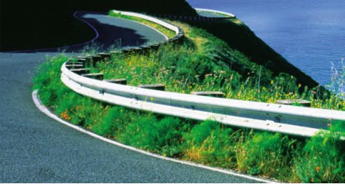

Slide 4
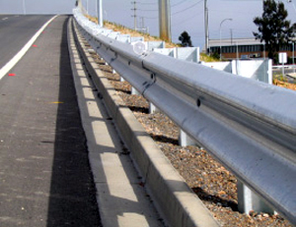
The purpose of the guardrail is to keep you our of danger

Slide 5
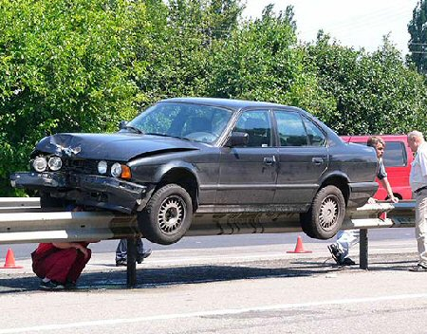
Guardrails
Hitting guardrails will cause some damage, but it keeps you from destroying your life

Slide 6
God’s guardrails for your life
Guardrails restrict

Slide 8
Proverbs 14:15 The simple believe anything, but the prudent give thought to their steps. (NIV)

Slide 9
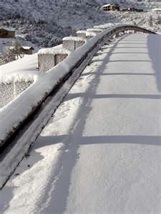
Proverbs 2:11 Discretion will guard you, understanding will watch over you,

Slide 10
Proverbs 27:12 The prudent see danger and take refuge, but the simple keep going and pay the penalty. (NIV)

Slide 11
God’s word is designed to make us live the best
Deuteronomy 6:24
So the LORD commanded us to observe all these statutes, to fear the LORD our God for our good always and for our survival, as it is today.
John 10:10 The thief comes only to steal and kill and destroy; I came that they may have life, and have it abundantly.

Slide 12
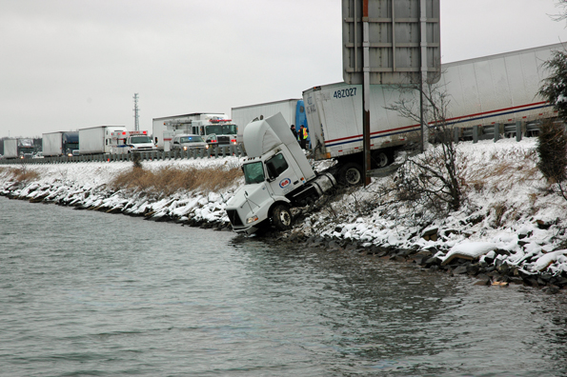
Without these guardrails we travel deeper and deeper and closer and closer to wrong

Slide 13
Guardrails
2 John 8 Watch yourselves, that you do not lose what we have accomplished, but that you may receive a full reward.

Slide 14
Guardrails
1 Pet 5:8 Be of sober spirit, be on the alert. Your adversary, the devil, prowls around like a roaring lion, seeking someone to devour.

Slide 15
Guardrails
Matthew 7:15
“Beware of the false prophets, who come to you in sheep’s clothing, but inwardly are ravenous wolves.”

Slide 16
Guardrails
1 Tim 6:20 “O Timothy, guard what has been entrusted to you, avoiding worldly and empty chatter and the opposing arguments of what is falsely called "knowledge"--

Slide 17
Culture believes that they have guardrails
Drink responsibly
Don’t have sex until you’re ready
Parents talk to your kids about drugs

Slide 18
God’s guardrails for your life
1 Cor 15:33 Do not be deceived: "Bad company corrupts good morals."

Slide 19
God’s guardrails for your life
2 Tim 2:22 Now flee from youthful lusts, and pursue righteousness, faith, love and peace, with those who call on the Lord from a pure heart.

Slide 20
God’s guardrails work when our conscience hits them
Guilt is the feeling you have when you are wrong

Slide 21
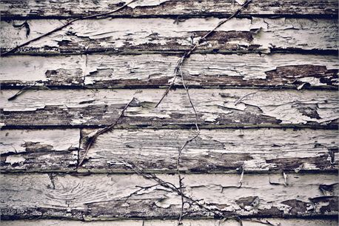
Genesis 3:7-8 Then the eyes of both of them were opened, and they knew that they were naked; and they sewed fig leaves together and made themselves loin coverings. They heard the sound of the LORD God walking in the garden in the cool of the day, and the man and his wife hid themselves from the presence of the LORD God among the trees of the garden.

Slide 22
Genesis 3:7-8 Then the eyes of both of them were opened, and they knew that they were naked; and they sewed fig leaves together and made themselves loin coverings. They heard the sound of the LORD God walking in the garden in the cool of the day, and the man and his wife hid themselves from the presence of the LORD God among the trees of the garden.

Slide 23
Joshua 7:20-21 So Achan answered Joshua and said, “Truly, I have sinned against the LORD, the God of Israel, and this is what I did: when I saw among the spoil a beautiful mantle from Shinar and two hundred shekels of silver and a bar of gold fifty shekels in weight, then I coveted them and took them; and behold, they are concealed in the earth inside my tent with the silver underneath it.”

Slide 24
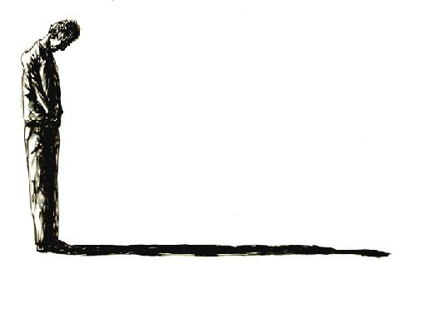
Acts 2:37 Now when they heard this, they were pierced to the heart, and said to Peter and the rest of the apostles, “Brethren, what shall we do?”
Acts 5:33 But when they heard this, they were cut to the quick and intended to kill them.

Slide 25
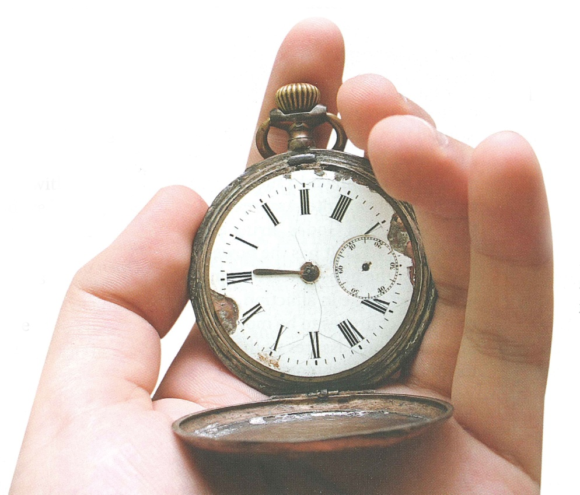
When you violate your conscience, you feel like you’ve actually done wrong

Slide 26
We see examples of people living without guardrails
Hebrews 3:13
But encourage one another day after day, as long as it is still called “Today,” so that none of you will be hardened by the deceitfulness of sin.
1 Timothy 4:2 by means of the hypocrisy of liars seared in their own conscience as with a branding iron,

Slide 27
Ephesians 4:19 and they, having become callous, have given themselves over to sensuality for the practice of every kind of impurity with greediness.

Slide 28
Jeremiah 6:15“Were they ashamed because of the abomination they have done? They were not even ashamed at all; They did not even know how to blush. Therefore they shall fall among those who fall; At the time that I punish them, They shall be cast down,” says the LORD.

Slide 29
Living without guardrails is a life that is destined to crash
Guardrails
Clueless to what lies ahead
They put self and others in danger

Slide 30
Ephesians 4:25-5:21
Be careful how you walk (15)
Understand the will of God (17)
Be filled with the Spirit (18)

Slide 31
God’s guardrails for your life

